Slide 1
Behavioral Characteristics
Diversity in Death of a Salesman

Slide 2
Behaviors
Behavior as defined by Merriam-Webster is the manner in conducting oneself
Explanation of one’s actions and responses
Diversity is referred to as “all of the ways in which people are different” according to Diversity Consciousness
Different behaviors, personalities, are one way to determine diversity.
Communication in Our Lives textbook wrote about was the link between communication and self worth. “When others are more successful around us our own achievements are lost”.

Slide 3
Willy Loman
Behavioral characteristics are prominent in this character. He exhibits many signs of his diversity when compared to his neighbors and his own family
Specifics of Willy’s behavior
  Distraught – Throughout the play he seems to be distraught with his situation (lack of success, family success, getting older)
  Manic – Towards the end of the play Willy has trouble forming thoughts and remembering. He seems to be running everywhere but never getting anywhere.

Slide 4
Linda Loman
Linda Loman showed mysterious behaviors in her character.
Her behaviors were what kept her character interesting. She exhibited specific behaviors of being…
  Composed – Mostly Linda has her feeling under control always focusing on other people or chores rather than her own feelings
  Understanding – Throughout the play she was understanding of Willy’s troubles and her two son’s confusion with life

Slide 5
Biff and Happy Loman
Biff and Happy were characters that were much like their father, Willy. They were very expressive with their behaviors.
Specific examples include…
  Exacerbated- Biff and Willy’s conversations always seemed to exhibit this behavior. His behavior also stems from the way his life is going, not as successful as hoped.
  Philandering- Happy is described as being a “philandering bum” by his mother. He seems to not know what he wants out of his life or where he wants to go.

Slide 6
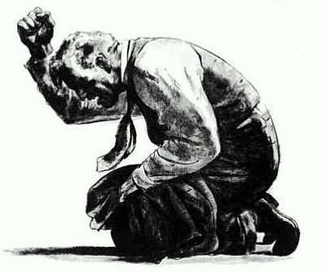
Questions or Comments?

